Slide 1
WELCOME
MongoDB SI Certification Presentation
Name Role Company Date

Slide 2
Customer Overview Use-case Description Problem Statement 3 Whys Current Architecture Landscape Proposed Architecture Landscape --- below is pick choose apply --- Modernization Scorecard TCO/Pricing Competition Comparison Analysis Customer Case Study

Slide 3
Customer Overview
This is a brief introduction to the customer, the vertical and what their business does.

Slide 4
Use Case Description
What is the use case? What is it that this application does? What is the purpose of this application?

Slide 5
Problem Statement
What is the overall problem that we are trying to solve? What are the negative consequences of this problem?
Some examples are:
Is the company losing revenue?
Is the company losing customers?

Slide 6
3 Whys
Why do anything?
Why should we do anything to solve this business problem?
Why Now?
If we don’t solve this problem right now, what would the consequences be?
Why MongoDB?
Why is MongoDB a good fit to solve this problem now?

Slide 7
Current Architecture
This is a BEFORE architecture diagram showing the current state architecture.
A description of the current architecture and the tech stack involved.

Slide 8
Proposed Architecture
This is an AFTER architecture diagram showing the proposed architecture with MongoDB.
A description of the architecture with MongoDB and the tech stack involved.

Slide 9
Modernization Scorecard
Please attach a screenshot of the summary page
or a simple list of conclusions,
as a result of using
the modernization scorecard

Slide 10
TCO/Pricing
This is a TCO/Pricing Analysis of a before and after scenario.
What is it costing the customer today?
What will it cost the customer with MongoDB?
How much money will the customer save with MongoDB?

Slide 11
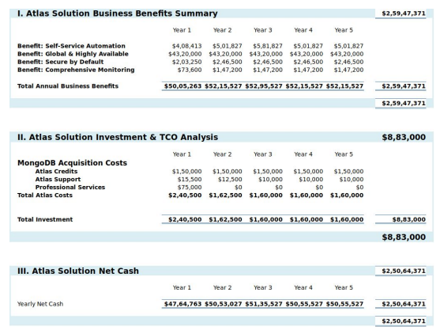
TCO Example
Some useful models:
https://view.highspot.com/viewer/5f646d71b7b7392a0be1ef56

Slide 12
Competition Comparison
This section is to list/highlight/compare why MongoDB is a better fit than the current architecture technology.
Are there any limitations that the current architecture has that is causing problems for the application?
Consider lining up another database or two in column format

Slide 13
Customer Case Study
Give examples of where MongoDB has solved this problem before.
See this for some examples:
https://www.mongodb.com/use-cases https://www.mongodb.com/who-uses-mongodb

